Slide 1
Multibeam Advisory Committee
Vicki Ferrini (Lamont-Doherty Earth Observatory)
Paul Johnson (UNH/CCOM-JHC)
Kevin Jerram (UNH/CCOM-JHC)

Slide 2
What is the Multibeam Advisory Committee?
Initially funded in 2011 for a 3 year period by the National Science Foundation
Funded for a 2nd time in spring 2015
Committee is composed of:
  Vick Ferrini (Lamont)
  Paul Johnson (UNH)
  Kevin Jerram (UNH)
A community-based effort with the goal of ensuring that consistent high-quality multibeam data are collected across the U.S. Academic Research Fleet.

Slide 3
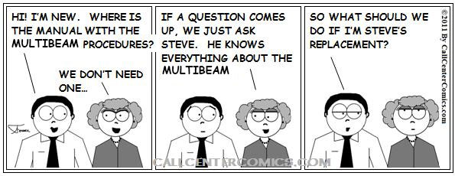
What was the problem ?
Modified From: http://evillusionist.files.wordpress.com/2012/05/call-center-cartoon-149.jpg
The vessels of the U.S. Academic fleet are used for many different types of oceanographic work.
Multibeam systems are just one of many complex sensors on each ship.
The challenge of “Tribal Knowledge”
Operation in isolation.

Slide 4
Why Is It Important ?
Opportunistic Collection Of Bathymetric Data On Non-Mapping Cruises
Every Ping Counts!
NSF Workshop in 2010 Identified a strong need
to coordinate operational efforts across the fleet
MAC Proposal Funded In 2011 & 2015

Slide 5

Multibeam Advisory Committee (MAC)
SAT - Ensure all hull-mounted multibeam systems are installed, calibrated, and configured properly and consistently (Johnson, Jerram, Flinders Beaudoin,, Greenaway, & JHC)
ANT - Perform acoustic noise tests to assess and potentially improve sensor efficiency (coverage) and data quality (Gates)
QAT - Ensure multibeam sonar systems are operated in a consistent manner that maximizes data accuracy, precision, and scientific utility (Ferrini, Johnson, Jerram, Beaudoin)

Slide 6
Multibeam Advisory Committee (MAC)
ANT – QAT – SAT all have areas of overlap.
Tools and techniques developed for one area useful for all.
Begins with good communications with all stakeholders in community
  Operating Institutes
  Technicians
  Scientist
  Industry
Working with graduate students, NOAA, and experts in the field.

Slide 7
Ship | Multibeam System |  |  |  | MAC Technical Team
 | EM122 | EM302 | EM710 | Reson 8101 | SAT | ANT | QAT
Atlantis | X |  |  |  | 2011 | 2011 | 2016?
Healy | X |  |  |  |  | 2014
Kilo Moana | X |  | X |  | 2010 2012 2015 (x2) | 2010 | 2012
Langseth | X |  |  |  |  | 2011 | 2012 2013
Melville | X |  |  |  |  | 2012
Neil Armstrong | X |  | X |  | 2015 | 2015 | 2016
Palmer | X |  |  |  | 2014 2015 | 2014
Revelle |  |  |  |  |  | TBD | 2013
Sally Ride | X |  | X |  | 2016 | 2016 | 2016
Sikuliaq |  | X | X |  | 2014 | 2014 | 2014 2016
Thompson |  | X |  |  | 2010 | TBD | TBD
Hugh Sharp |  |  |  | X | 2012 |  | 2012
Italics – Not funded by MAC
Bold - Planned

Slide 8
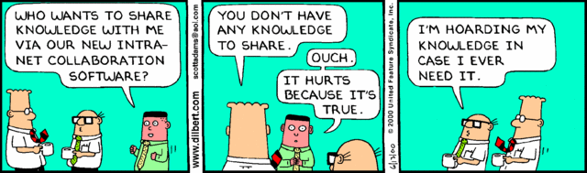
MAC – Helping the Multibeam Community
http://mac.unols.org
Technical Reports
Technical Resources
Help Desk
The Early Days of the MAC
Notes:
http://www.selfishprogramming.com/wp-content/uploads/2011/12/5-Stages-of-Tribal-Leadership.jpg

Slide 9
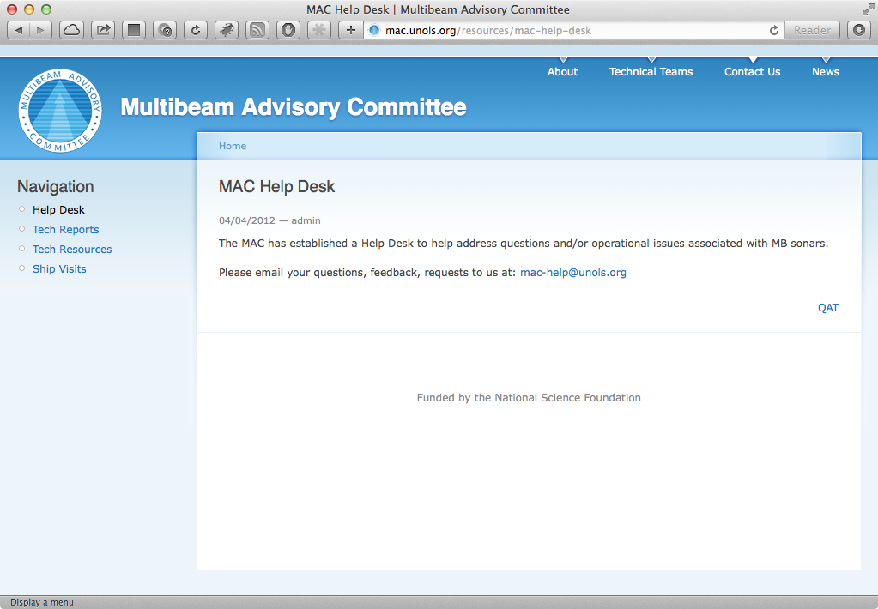
MAC Help Desk
mac-help@unols.org

Slide 10
2015 Activities
R/V Kilo Moana – April
  Quality Assessment
RVIB Palmer – June
  Shipboard Acceptance
R/V Kilo Moana – August
  Follow-up Quality Assessment

Slide 11
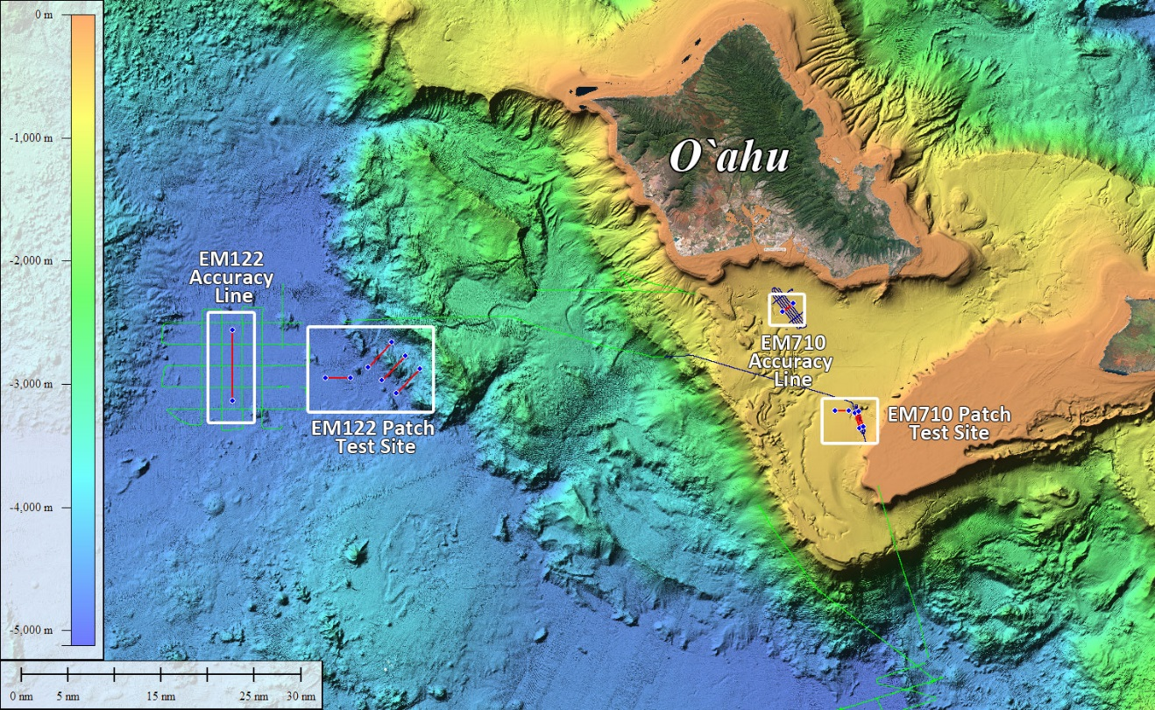
R/V Kilo Moana
1st vist in April
Plan:
  EM710 Patch Test
  EM122 Patch Test
  EM122 Accuracy Test
Reality:
  Successful EM710 Patch Test
  Severe apparent acoustic interference affecting the the EM122
  Testing halted

Slide 12
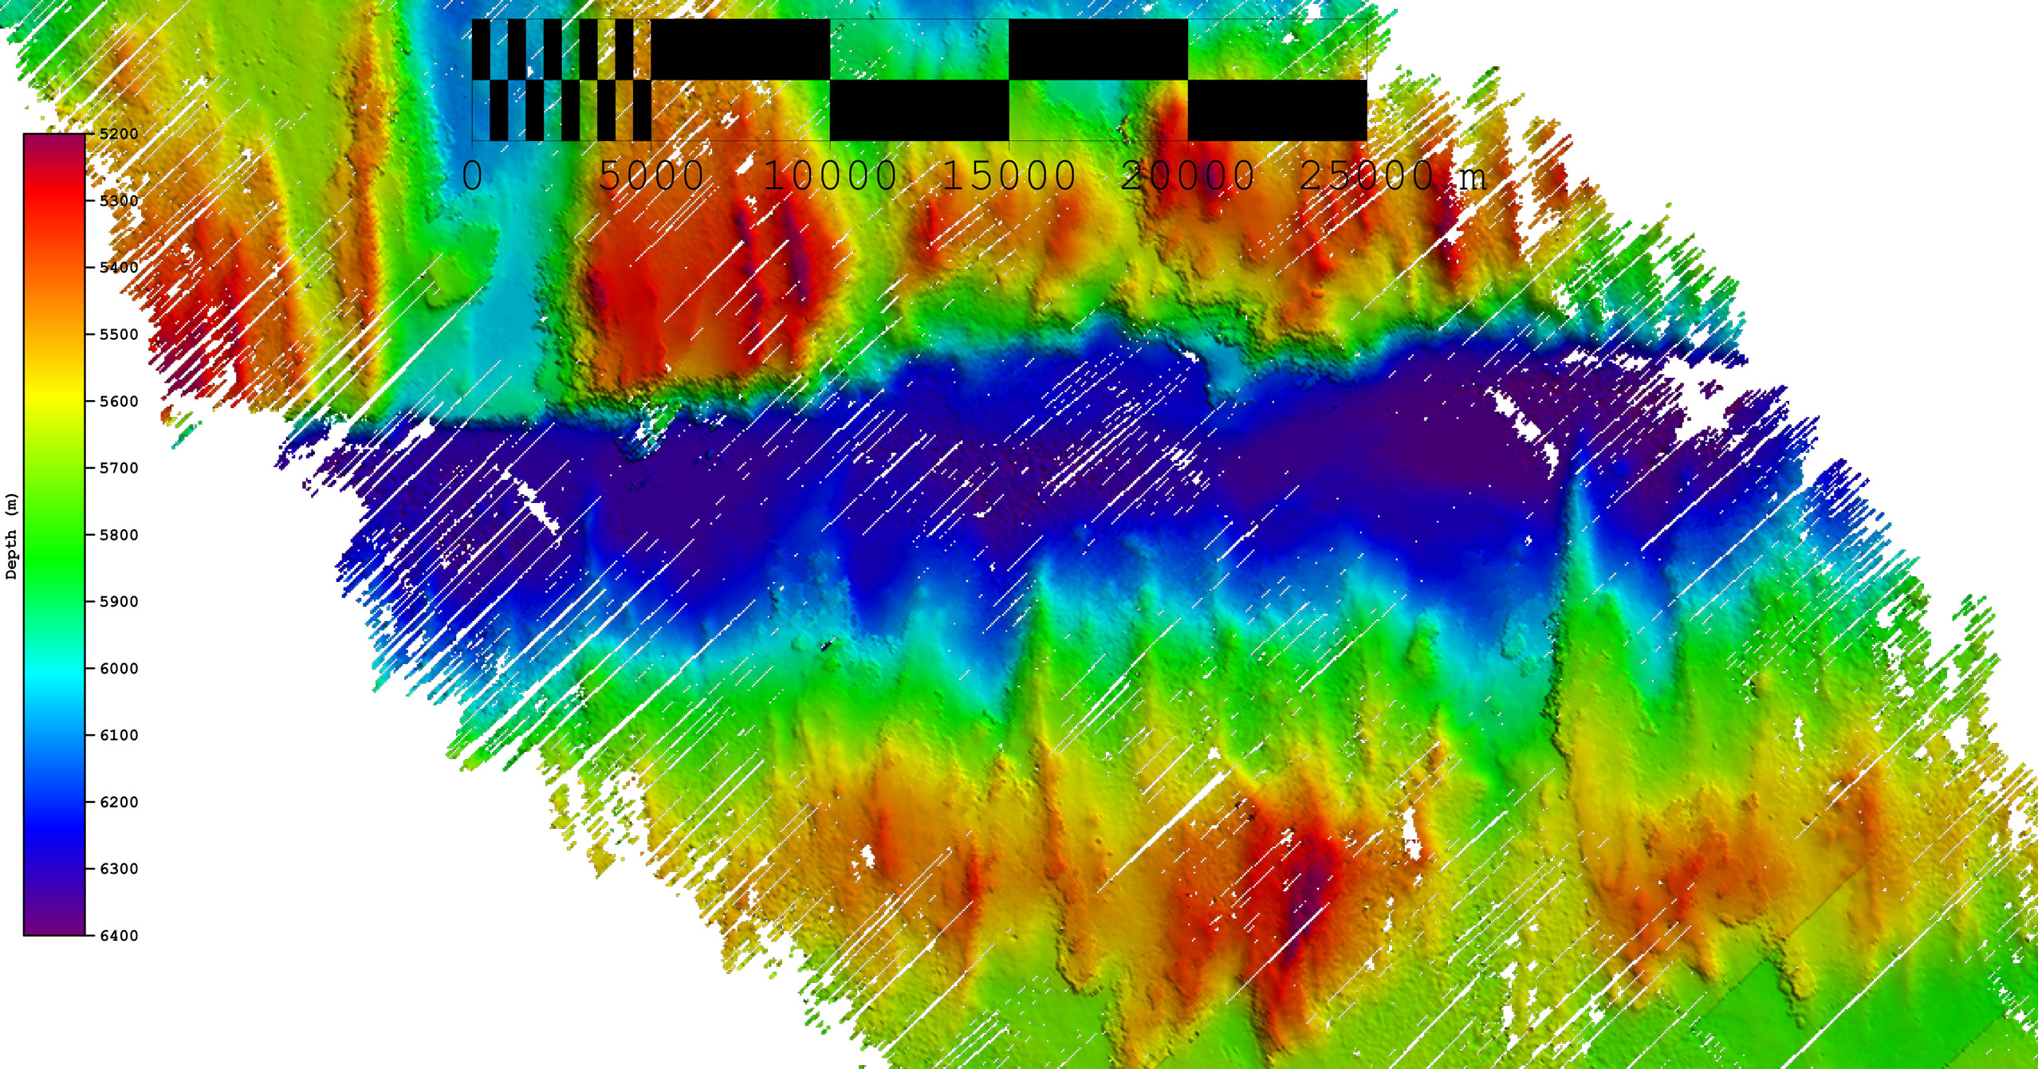
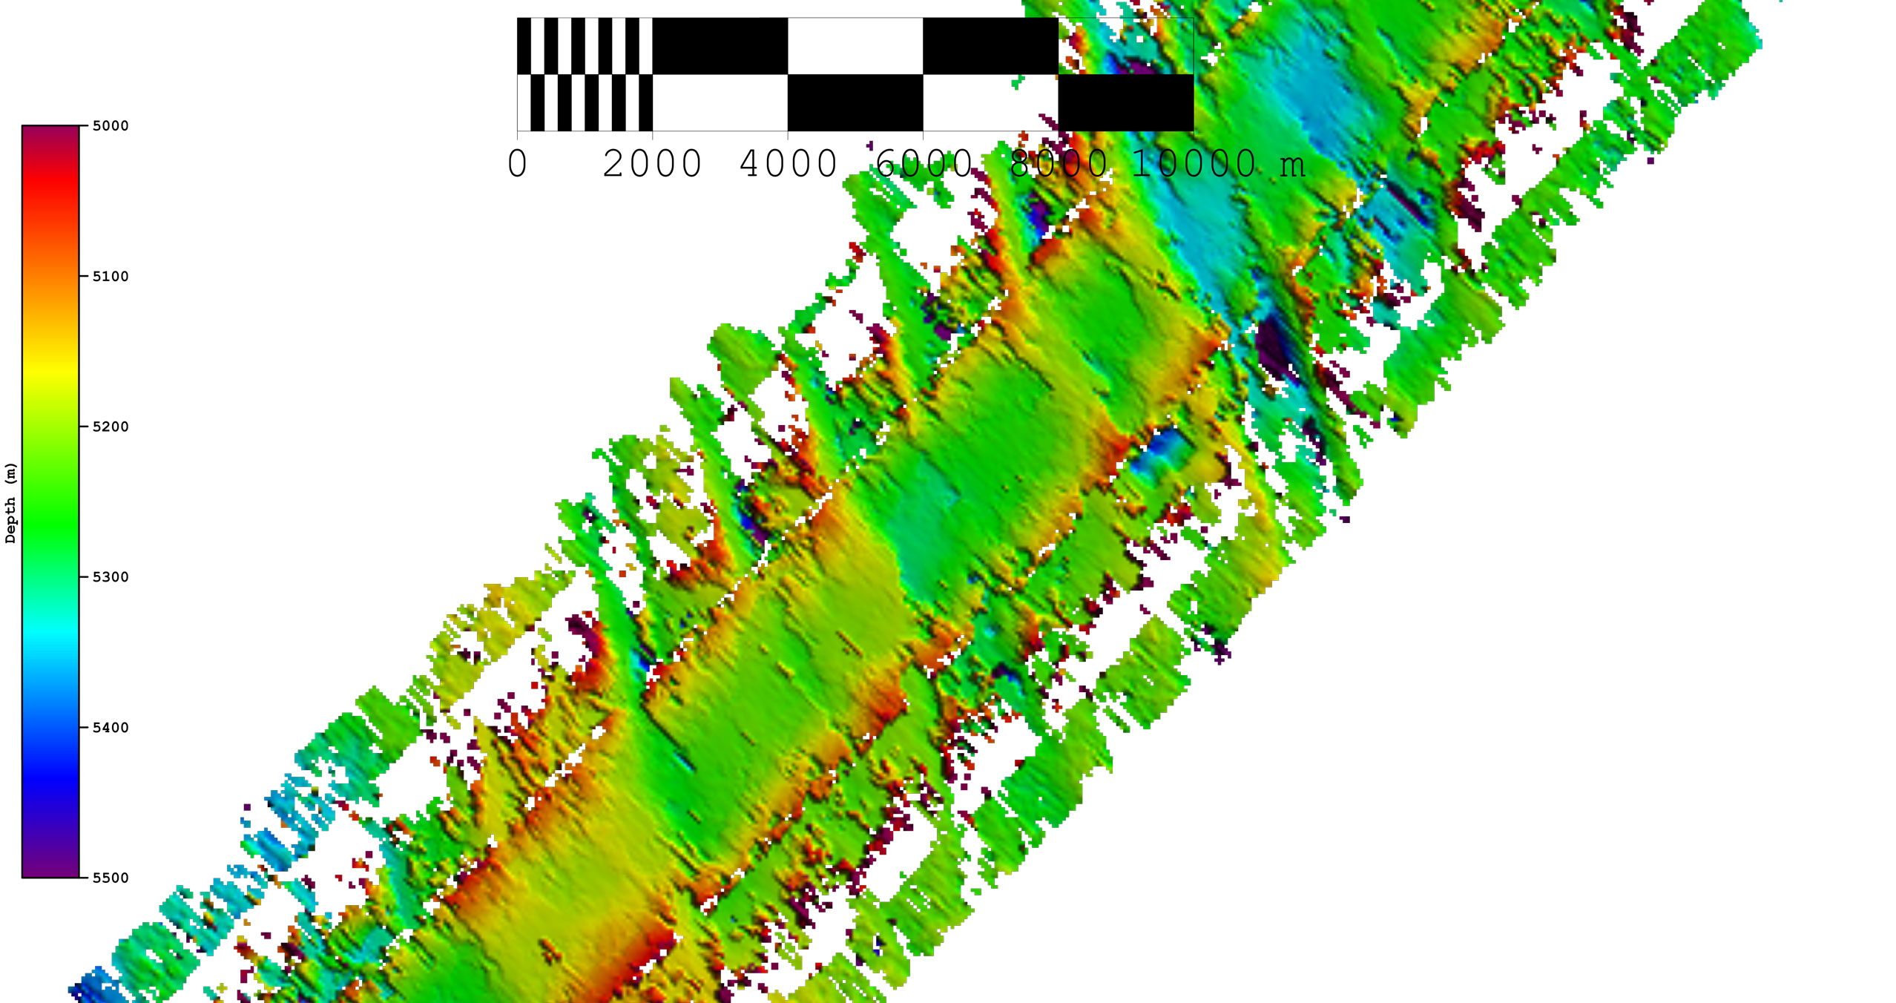
Pre-Shipyard
Post-Shipyard

Slide 13
R/V Kilo Moana – August 2015
Great Team
  Gates Acoustics
  UNH
  MAC
  Kongsberg
Splitting Time with ROV Operations
Multiple “a-ha” momments
Final solution was a miswired RX module installed in shipyard
Lucky wiring diagram find.

Slide 14
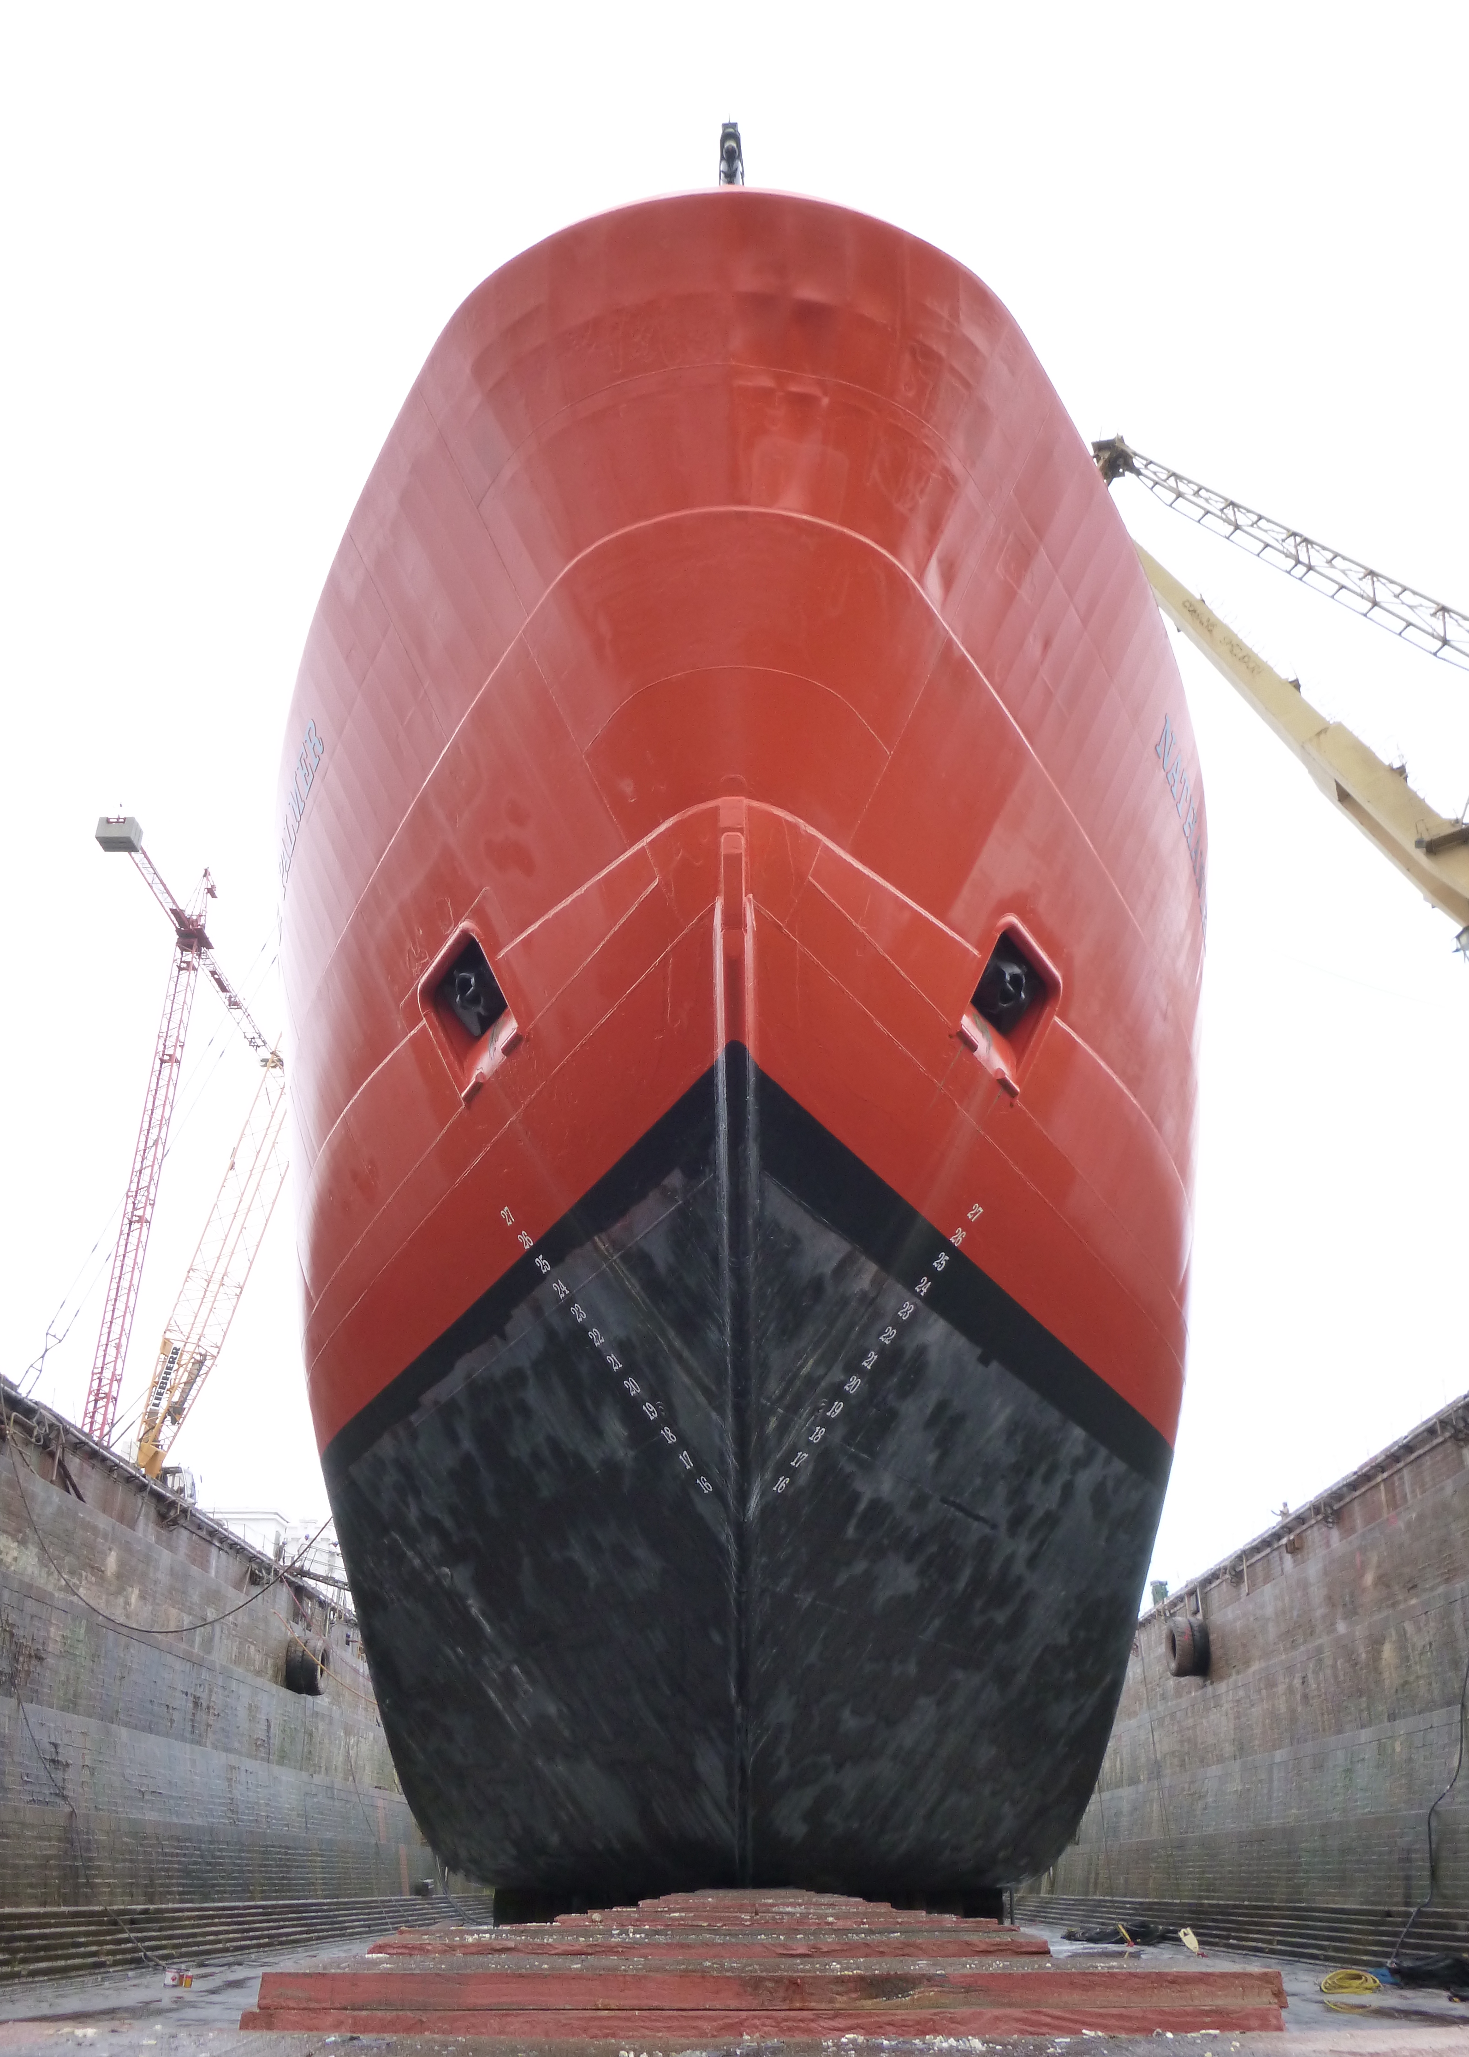
RVIB Nathaniel B. Palmer
  Kongsberg EM120 -> EM122 Upgrade
  Talcahuano, Chile
  2014 – EM122 Transceiver SAT
    suspected array degradation
  2015 – EM122 TX/RX Array SAT
    sensor survey in dry dock
    system geometry review
    calibration (patch test)
    accuracy assessment
    coverage assessment
    RX noise level tests
    TX channel BISTs

Slide 15
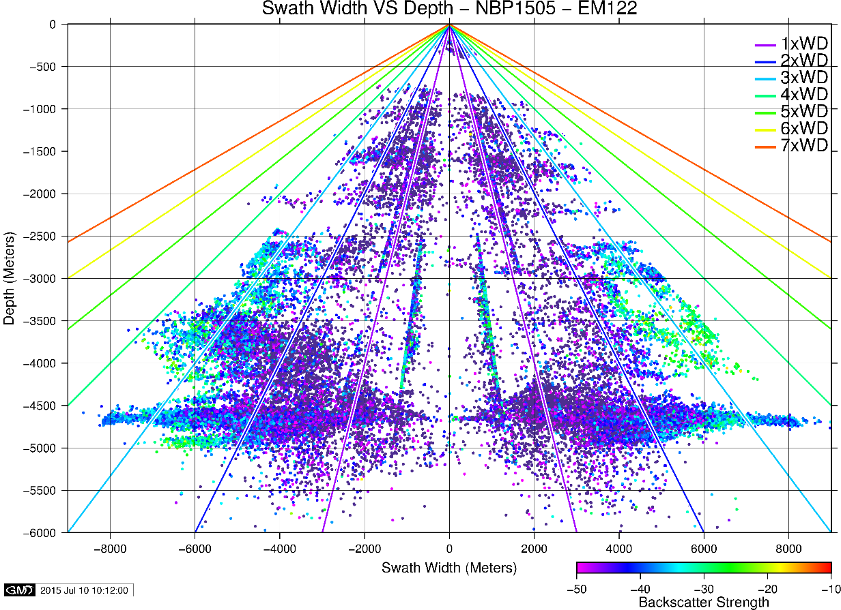
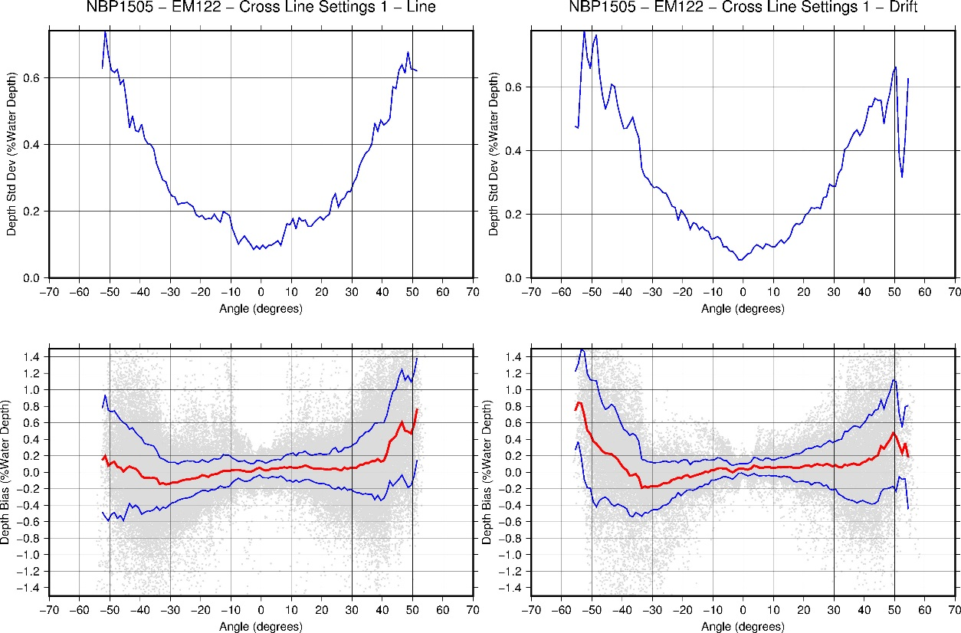
RVIB Nathaniel B. Palmer
  2015 – EM122 TX/RX Array SAT
  Results
    performance improved from 2014
    increased TX power
    stronger bottom returns
    wider swath coverage
    ship noise unchanged (12 kHz)
  Challenges
    sea state (bubble interference)
  Moving Forward
    more data, more BISTs
    unify sensor reference frames

Slide 16
2016 Activities
  At Sea
    R/V Neil Armstrong – SAT - Spring
    R/V Sally Ride – SAT - Spring/Summer
    R/V Atlantis - QAT - ?
    R/V Sikuliaq - QAT - ?
  On Land
    BIST Database and Visualization
    SVP Editor Installation Package (CCOM building off MAC)
    Cookbooks (Caris, Qimera, etc.)

